Slide 1
Comparative genomics Bioinformatics Applications (PLPTH813)
Sanzhen Liu
3/30/2023

Slide 2
Assembly statistics – N50
N50: A statistic used for assessing the contiguity of a genome assembly.
The contigs in an assembly are sorted by size and added, starting with the largest. The contig N50 is the size of the contig that makes the total greater than or equal to 50% of the total contig size.
1
2
3
4
Total length of 1-4 >=T/2
5
6
7
8
9
10
11
T=total length (bp)

Slide 3
Long-read assemblies
Software | Description
Canu | K-mer-based overlap computation
FALCON | Assembles phased diploid genomes
Flye | Uses A-Bruijn graph

Slide 4
Contig polishing
Software | Description
Arrow | Assembly error correction with PacBio long-read alignments
Nanopolish | Assembly error correction using voltage (raw) Nanopore data
Pilon | Assembly error correction using Illumina data

Slide 5
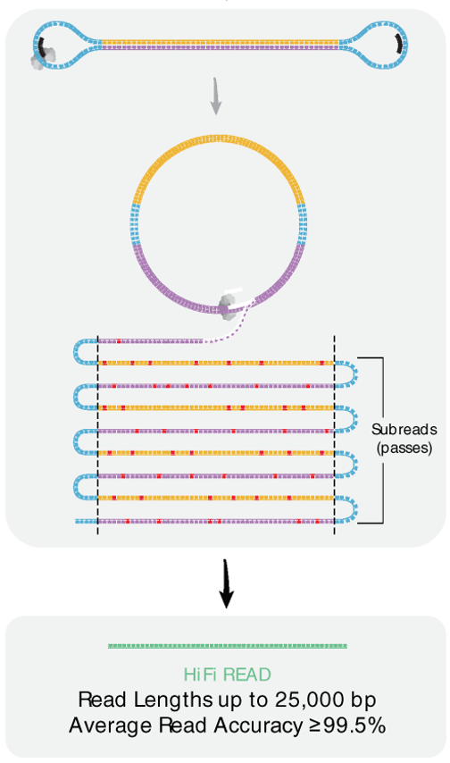
Assembly meets long HiFi PacBio reads
hifiasm:
High-contiguity assembly
fast
https://github.com/chhylp123/hifiasm

Slide 6
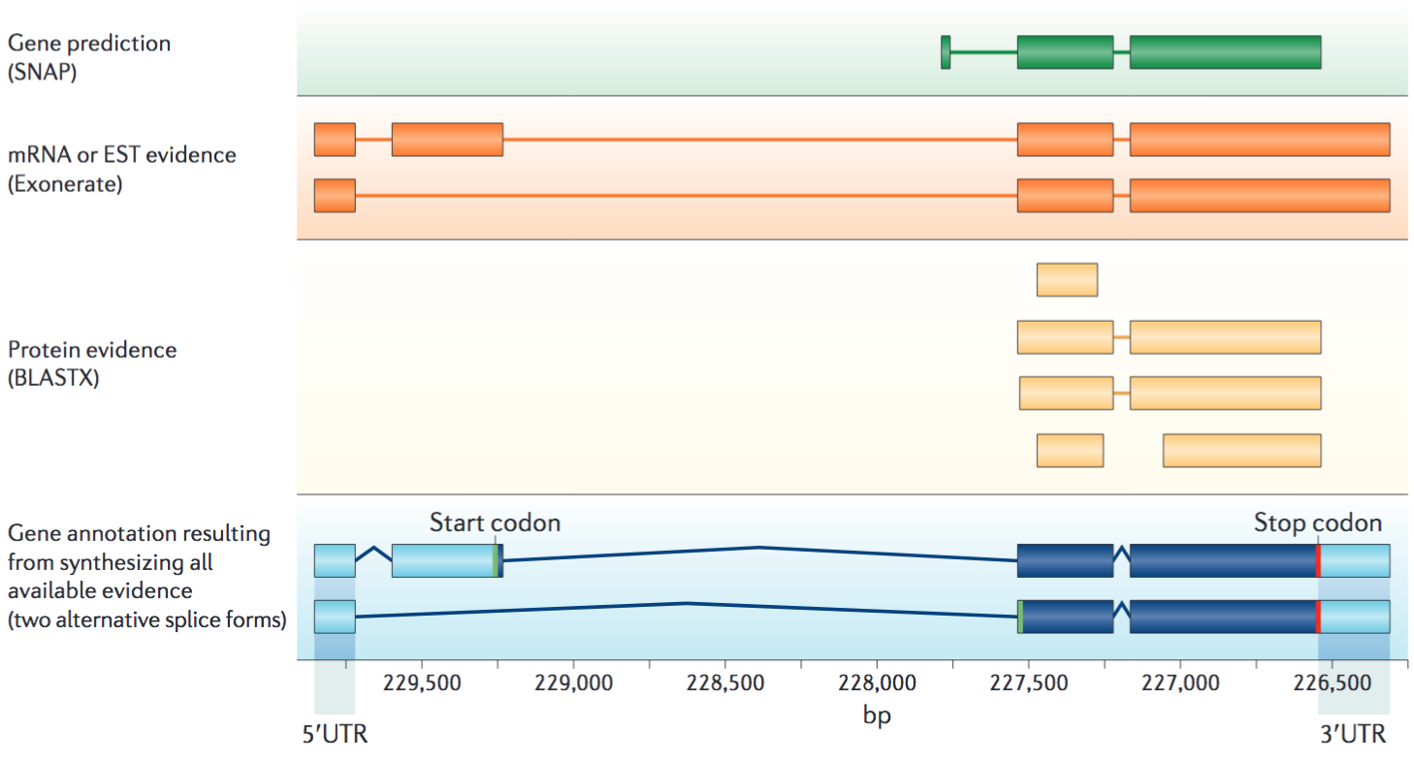
Gene annotation: ab initio prediction + evidence
Nature Reviews Genetics 13:329–342 (2012)

Slide 7
Assembly strategy of a large maize genome
Phase - I
Nanopore long reads (90X)
canu
Canu asm, Nanopolish
Illumina (90X)
polishing
Polished contigs
Mt; Pt
Phase - II
BioNano map
GBS of DH lines
hybrid
scaffold
mstmap
scaffolds + contigs
Genetic map
ALLMAPS
pseudochr
scaffolds + contigs

Slide 8
Outline
Introduction of comparative genomics and structural variation
Approaches
Comparative genome hybridization
Paired-end reads
Read depth
Whole genome assembly
Pangenomics
Case study: CGRD

Slide 9
Comparative genomics among genomes
Conservation and variability
Homologs: Genomic regions derived from a common ancestral gene.
Orthologs: Homologs from the divergence of lineages.
Paralogs: Homologs derived from their duplication within a lineage.
Homeologs: The subset of paralogs created by WGD. (synonyms: ohnolog; syntenic paralog)

Slide 10
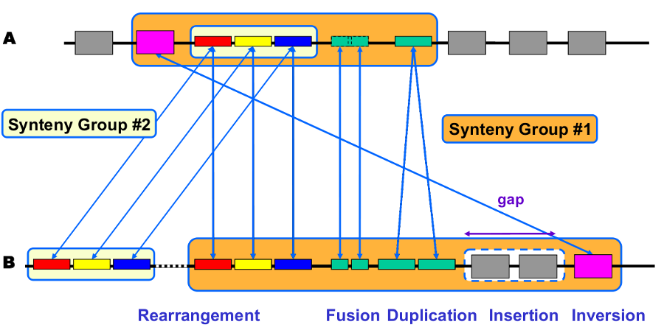
Synteny
Synteny is usually referred to as the conservation of blocks of order within two sets of chromosomes that are being compared with each other. Syntenic regions are evidence by homologous genes arranged in a collinear order.
genoscope.cns.fr

Slide 11
Intra-species genome rearrangements and structural variation (SV)
Variation of hundreds of bp to several Mb in size
Balanced variation
- Inversion
- Translocation
Unbalanced variation:
- Copy number variation (CNV)
(Presence/Absence variation, PAV)

Slide 12
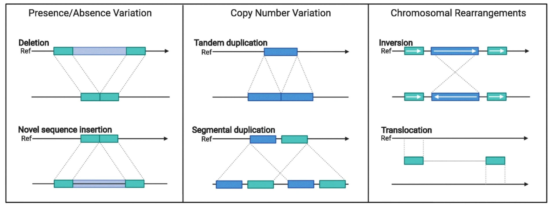
Structure variation types within species
Coletta et al., Genome Biol, 2021

Slide 13
Outline
Introduction of comparative genomics and structural variation
Approaches
Comparative genome hybridization
Paired-end reads
Read depth
Whole genome assembly
Pangenomics
Case study: CGRD

Slide 14
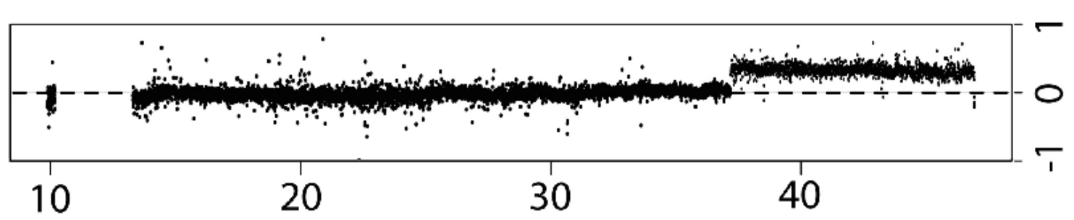
array Comparative Genomic Hybridization (aCGH)
A
+
B
array
Red signal (A)
Blue signal (B)
Log2 (A/B)

Slide 15
NGS provides information for the discovery of variants, including structural variation

Slide 16

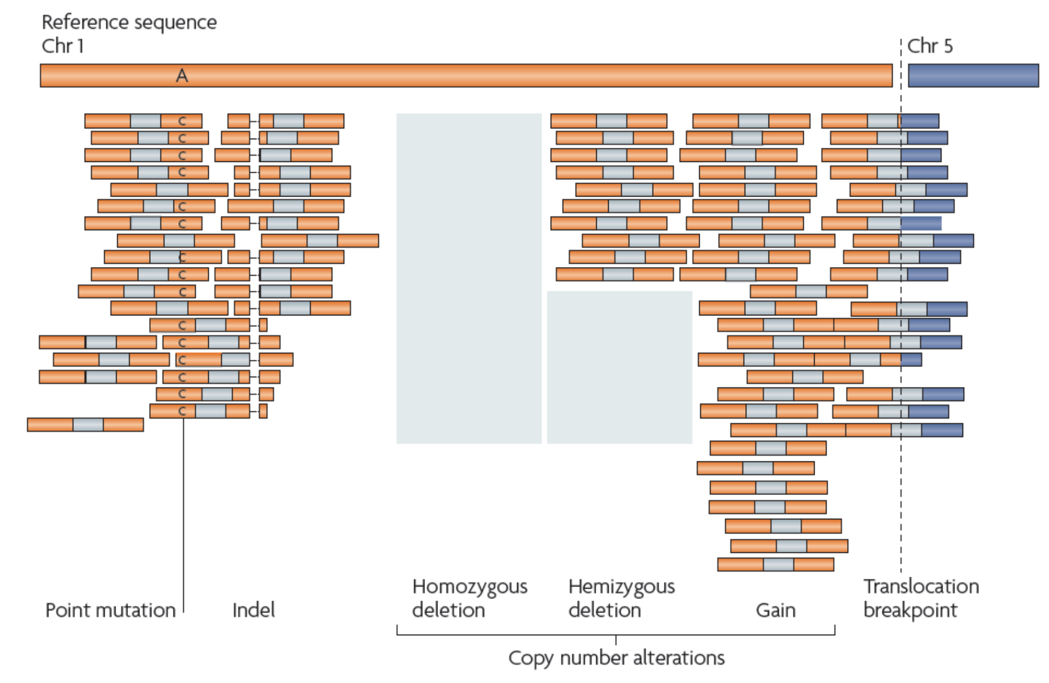
Variants in sequencing reads
Paired-end

Slide 17
Paired-end reads to find "deletion" relative to the reference
......
800 bp
Reference genome
newly sequenced genome
Paired-end read
insertion size = 380 bp

Slide 18
Split reads to find "exact deletion sequence"
Reference genome
......
Reads
Deletion sequence

Slide 19
Paired-end reads to find "insertion" relative to the reference
210 bp
Reference genome
newly sequenced genome
Paired-end read
insertion
fragment size = 380 bp
The size of insertions that can be identified by PE reads is determined by fragment sizes and read lengths.

Slide 20
inversion
Reference genome
newly sequenced genome
split read
Reference genome
newly sequenced genome

Slide 21
Tandem duplication
Reference genome
newly sequenced genome

Slide 22
Translocation
Reference genome
chrA
chrB
newly sequenced genome

Slide 23
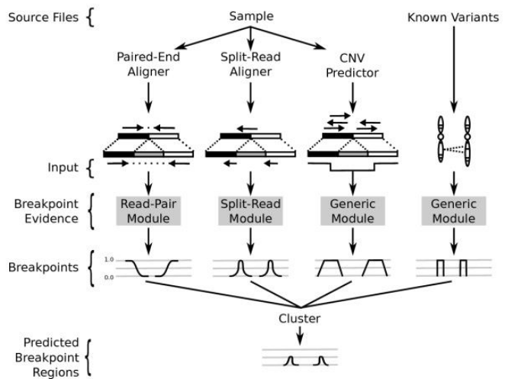
LUMPY: an integrative framework for SV discovery

Slide 24
Read depths
Reference
reads and alignment
copy numer 1 2 1 0 1
PCR bias (GC content, complicated structure)
Alignment bias (e.g., highly repetitive regions)
Nucleotide polymorphisms

Slide 25
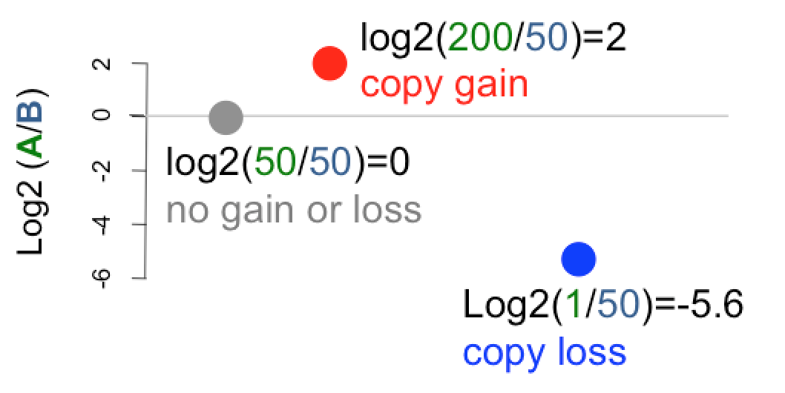
Read depths
B
A

Slide 26
Comparative Genomic Read Depth (CGRD)
CGRD is a pipeline to compare sequencing read depths from two samples along a reference genome.
define effective genomic bins each of which harbors certain non-repetitive sequences
align reads and count read depths per bin for both samples
combine neighbor bins with similar fold changes in read depth between the two samples (segmentation)

Slide 27
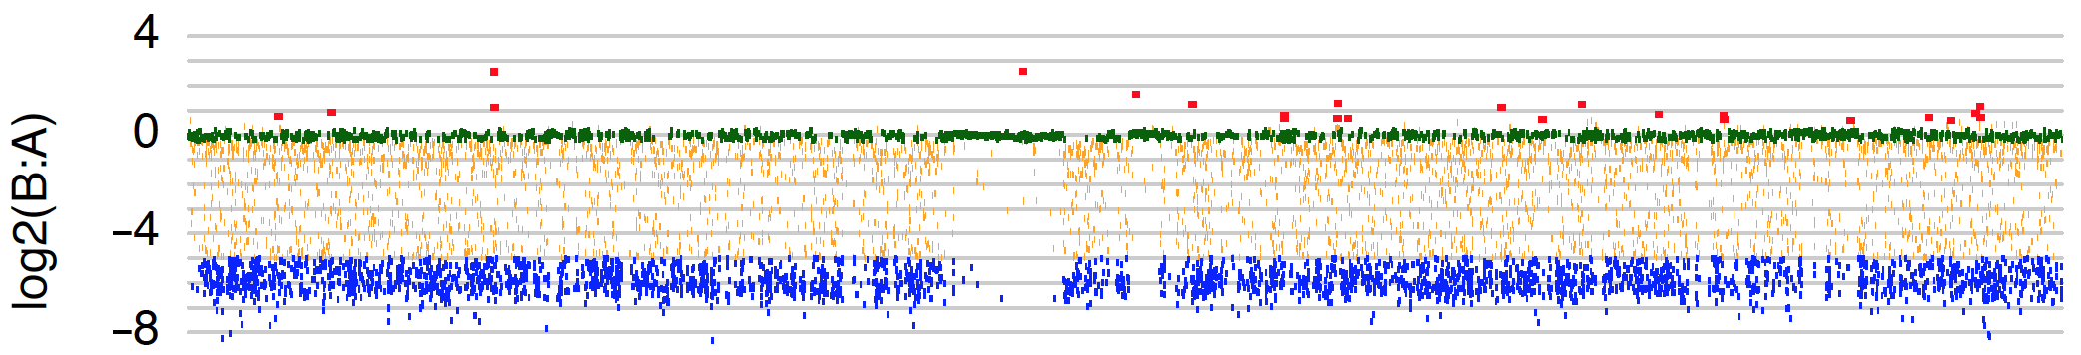

Comparative Genomic Read Depths (CGRD)
chr1
Physical coordinates
Red: B > A
Green: B = A
Blue: B < A

Slide 28
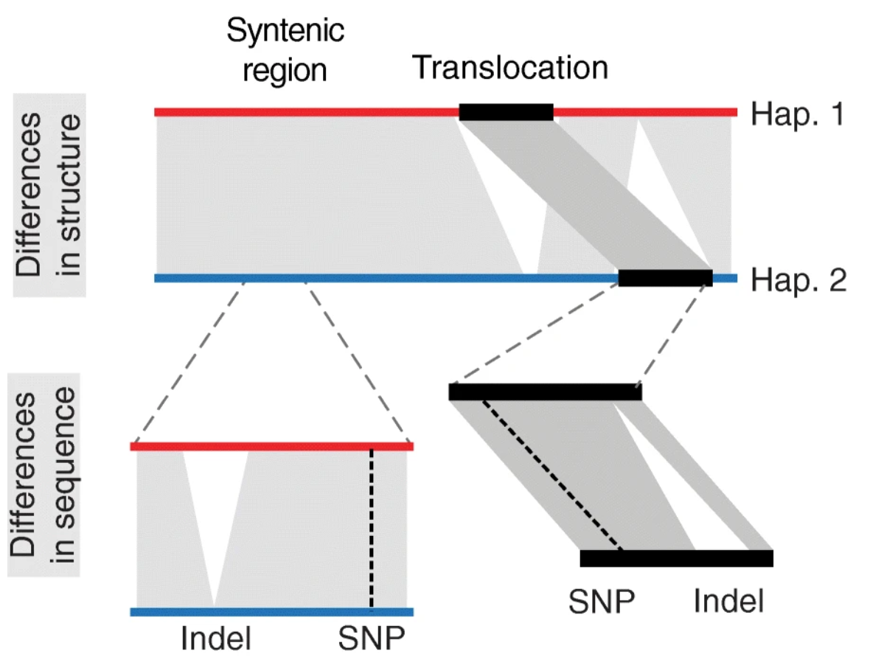
SyRI: finding genomic variation using whole-genome assemblies
Goel et al, 2019, Genome Biology, 20:277
Notes:
Goel et al, 2019, Genome Biology, 20:277

Slide 29
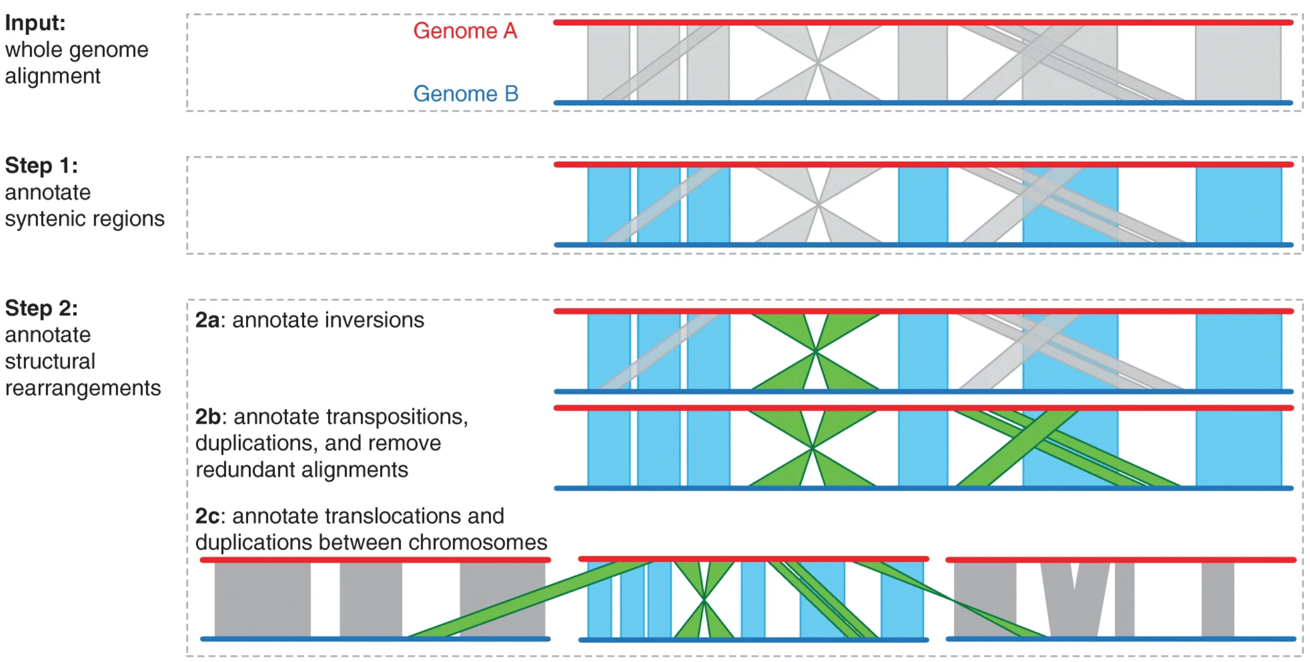
SyRI - algorithm
Aligner:
NUCmer
minimap2

Slide 30
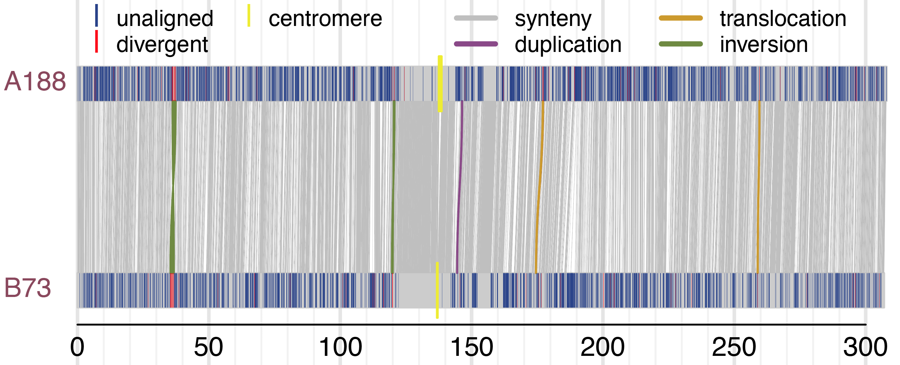
Structure variation with SyRI
SyRI is a tool using the genome assemblies to discover genomic rearrangement and local sequence differences (Goel et al., 2019)
Notes:
Goel, M., Sun, H., Jiao, WB. et al. SyRI: finding genomic rearrangements and local sequence differences from whole-genome assemblies. Genome Biol 20, 277 (2019). https://doi.org/10.1186/s13059-019-1911-0

Slide 31
Outline
Introduction of comparative genomics and structural variation
Approaches
Comparative genome hybridization
Paired-end reads
Read depth
Whole genome assembly
Pangenomics
Case study: CGRD

Slide 32
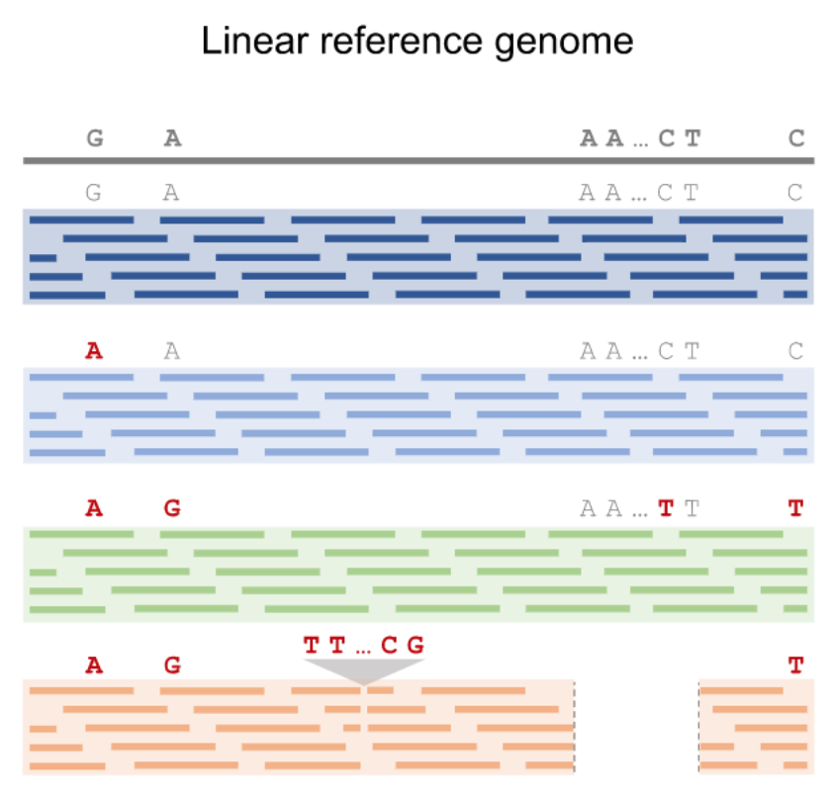
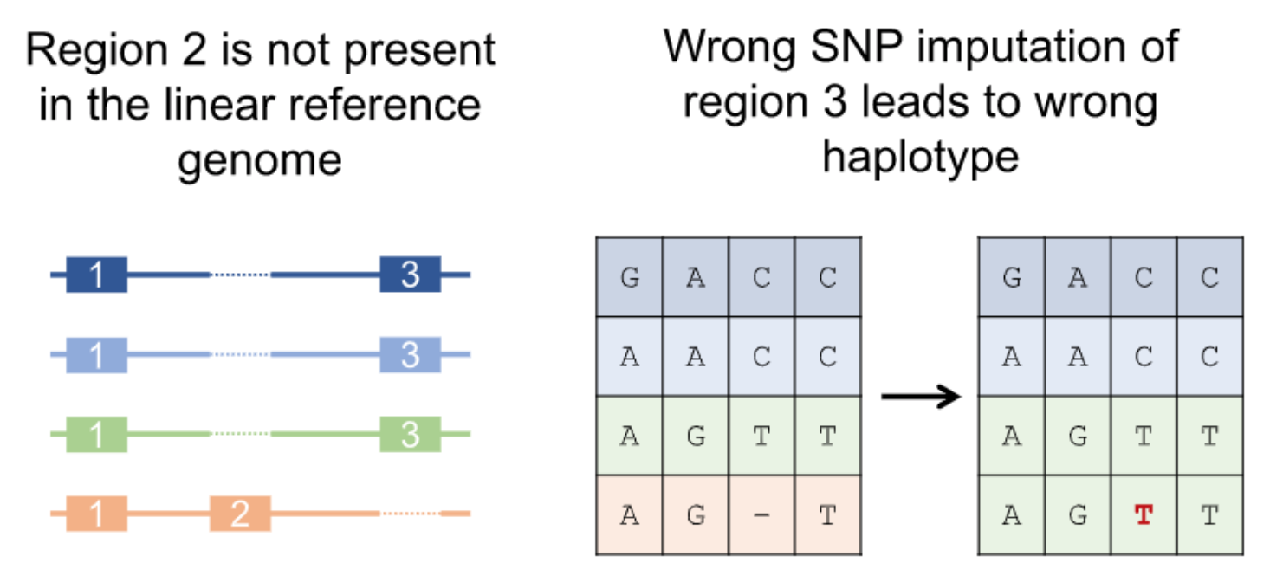
Issues associated with single reference genomes
Coletta et al., Genome Biol, 2021

Slide 33
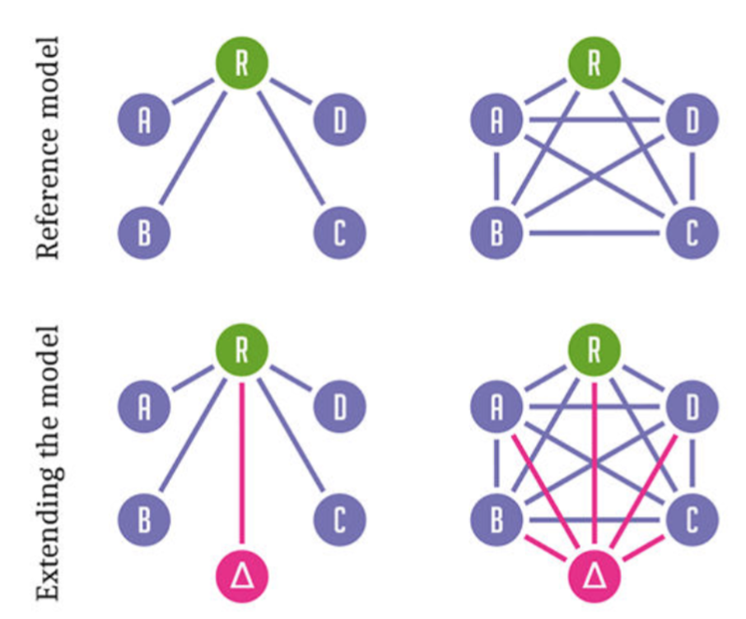
Pangenomics
Eizenga et al., 2020, Annual Review of Genomics and Human Genetics, 21:139-162

Slide 34
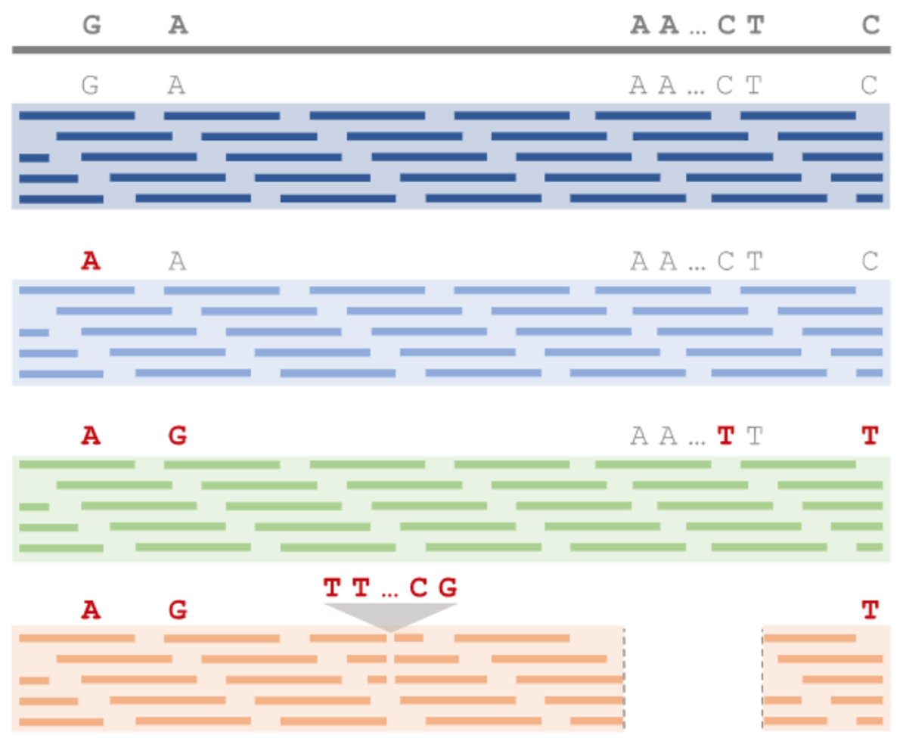
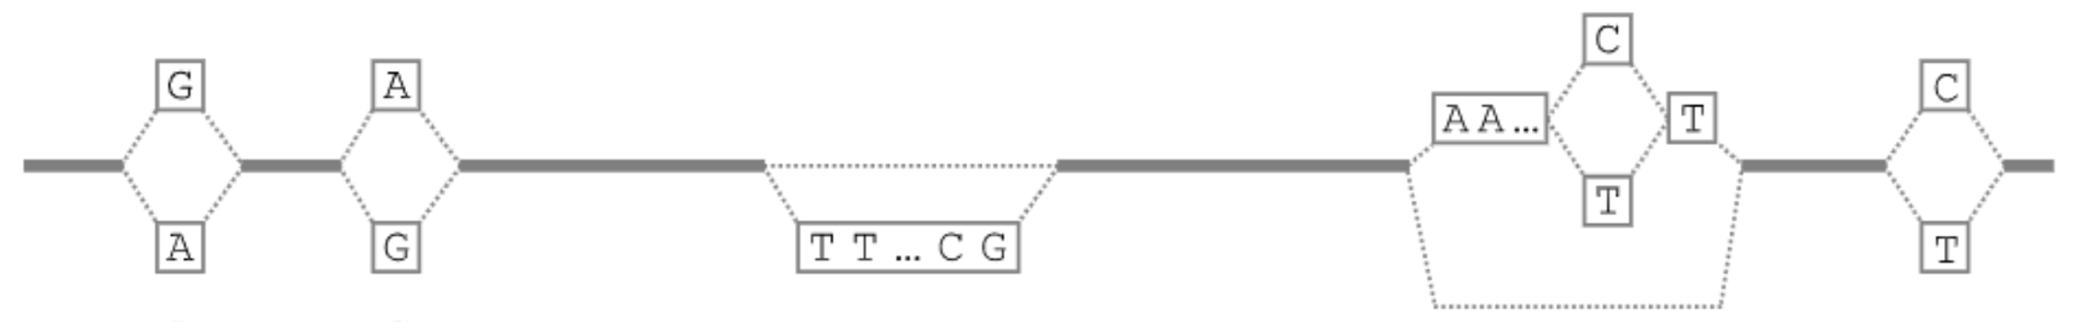
Construct a pangenome to facilitate genotyping

Slide 35
Outline
Introduction of comparative genomics and structural variation
Approaches
Comparative genome hybridization
Paired-end reads
Read depth
Whole genome assembly
Pangenomics
Case study: CGRD

Slide 36
MoT B71 final assembly vs. MG8 (70-15, rice strain)
Wheat blast fungus
Chr | Length (bp)
chr1 | 6,442,091
chr2 | 7,902,655
chr3 | 8,206,304
chr4 | 5,402,116
chr5 | 4,442,877
chr6 | 6,090,985
chr7 | 4,042,640
scaf1 | 941,816
scaf2 | 739,928
scaf3 | 104,670
scaf4 | 74,396
scaf5 | 69,131
Wheat
blast fungal strain
rice blast fungal reference
>10 kb overlap and >95% identity
Notes:
the two genomes are largely co-linear except for a few rearrangements, insertions, inversions.

Slide 37
Illumina sequencing of additional eight strains
Name | Year isolated | Host species | Isolation location
T25 | 1988 | Triticum | Paraná, Brazil
Py5020 | 2005 | Triticum | Paraná, Brazil
Py22.1 | 2007 | Triticum | Paraná, Brazil
B2 | 2011 | Triticum | Quirusillas, Bolivia
B71 | 2012 | Triticum | Okinawa, Bolivia
P3 | 2012 | Triticum | Canindeyú,Paraguay
P28 | 2014 | Bromus | Paraguay
P29 | 2014 | Bromus | Paraguay
B51 | 2012 | Eleusine | Quirusillas, Bolivia

Slide 38
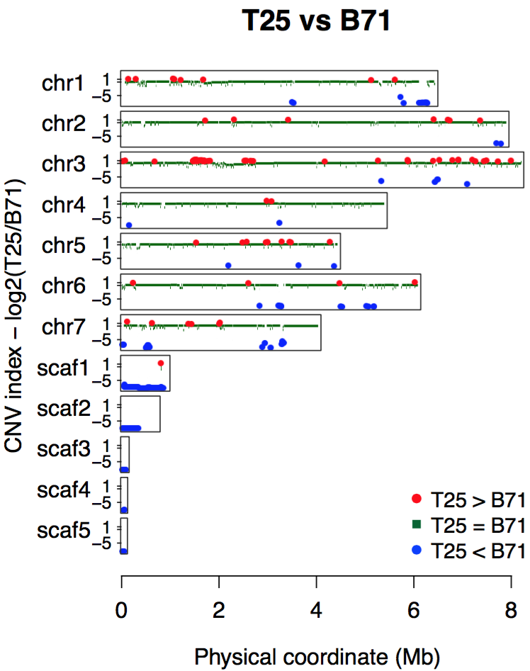
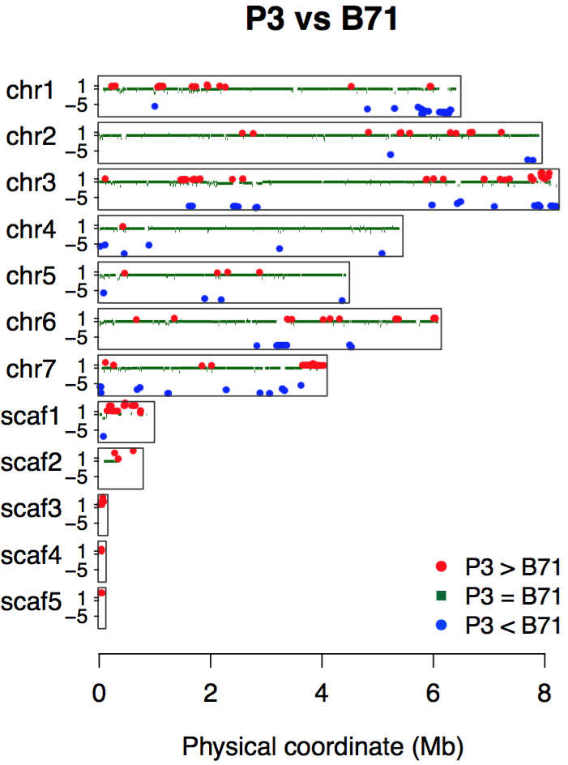
Read depths to infer copy number variation
Simply consider:
red: two copies in T25
green: conserved
blue: no copies in T25

Slide 39
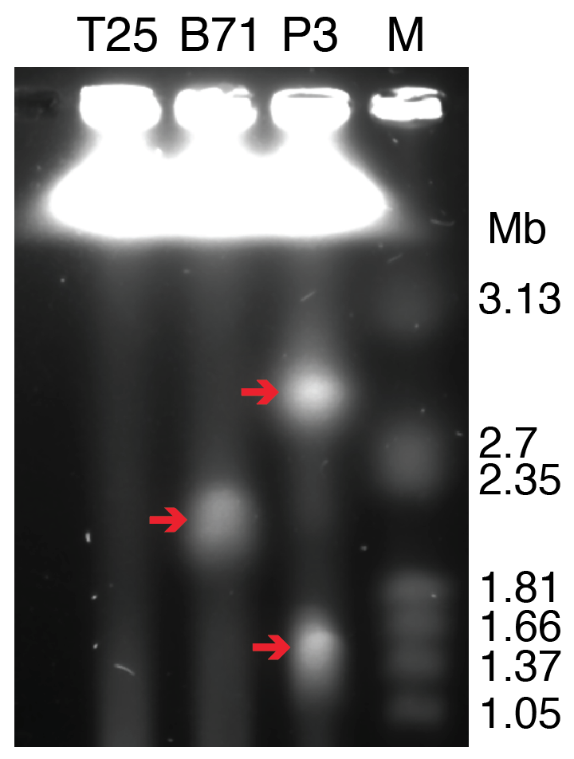
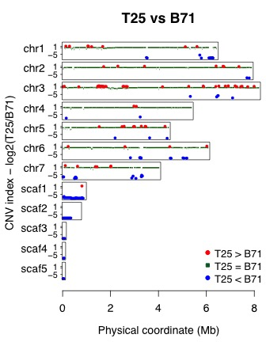
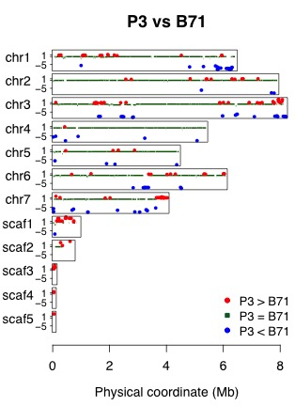
CHEF gel to separate chromosome-sized DNA
T25 has no mini-chromosomes
B71 has one and P3 has two
Notes:
the CNV results of scaffolds 1-5 match the mini-chromosome pattern

Slide 40
Additional References
Pinkel, D. & Albertson, D. G. Comparative genomic hybridization. Annu. Rev. Genomics Hum. Genet. 6, 331–354 (2005).
Miller, W., Makova, K. D., Nekrutenko, A. & Hardison, R. C. Comparative genomics. Annu. Rev. Genomics Hum. Genet. 5, 15–56 (2004).
Korbel, J. O. et al. Paired-end mapping reveals extensive structural variation in the human genome. Science 318, 420–426 (2007).
Armstrong, J., Fiddes, I. T., Diekhans, M. & Paten, B. Whole-Genome Alignment and Comparative Annotation. Annu Rev Anim Biosci (2018). doi:10.1146/annurev-animal-020518-115005
Kronenberg, Z. N. et al. High-resolution comparative analysis of great ape genomes. Science 360, (2018).

Slide 41
Tool collection

